Slide 1
Bank Churn and Customer Relationship Management Analysis
By Chethan kalyan

Slide 2


Problem Statement
During the previous fiscal year, Capstone Bank experienced a notable level of customer churn, prompting management to enlist the expertise of analytical specialists to devise solution.
Their objective is to diminish customer churn rates, enhance service delivery, and elevate overall customer satisfaction levels.

Slide 3


OBJECTIVE
IDENTIFY LOCATIONS
AND GENDER WHERE CHURN RATE IS MORE
ANALYZING THE CUSTOMER SEGMENTS FOR POTENTIAL CHURN
PROPOSE MEASURES
TO RETAIN CUSTOMERS FROM CHURN

Slide 4

Key Metrics
Total Customers
10000
Active Customer 5151
Inactive Customer
4849
Credit Card Holder
7055
Non Credit Card Holder
2950
Retained Customers 7963
Exited Customers 2037

Slide 5
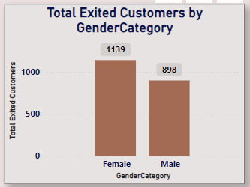
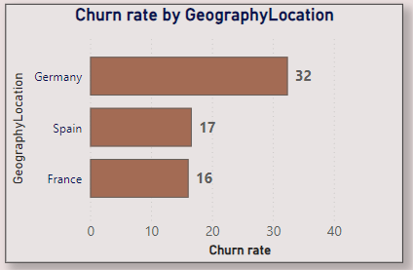
IDENTIFY LOCATIONS
AND GENDER WHERE CHURN RATE IS MORE
Analysis of the dataset indicates that Germany experiences a notably elevated churn rate in comparison to other countries. Moreover, female customers exhibit a higher likelihood of churning when juxtaposed with their male counterparts.

Slide 6
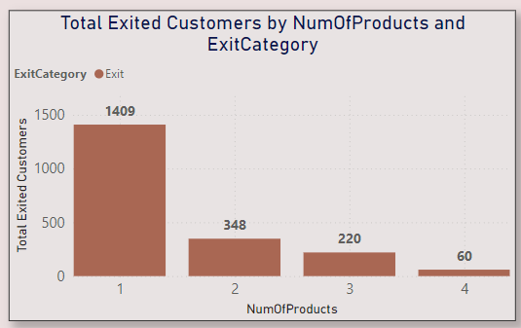
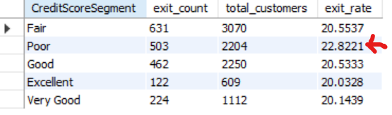
ANALYZING THE CUSTOMER SEGMENTS FOR POTENTIAL CHURN
Findings reveal that customers who exclusively utilize a single product from the bank display a heightened propensity for churn, suggesting a distinct customer segment at risk. Additionally, individuals with credit scores classified as poor exhibit the highest churn rate at 0.218, indicating this as a potential category for churn.

Slide 7
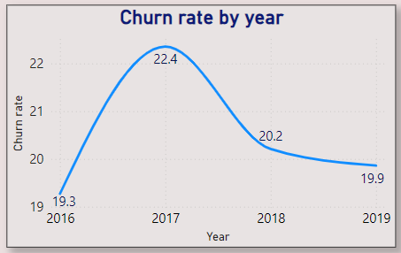
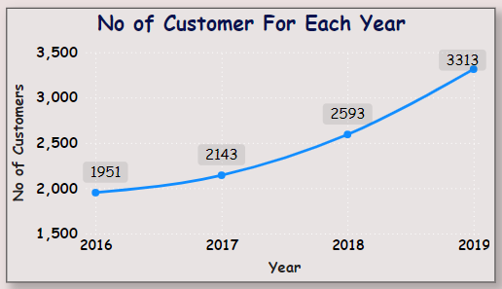
PROPOSE MEASURES
TO DECREASE CHURN RATE
The bank observes a positive trend in customer acquisition, with the number of new customers steadily rising each year, signaling a favorable development. Furthermore, there's a corresponding decline in the churn rate over the same period, indicating an encouraging trajectory. To leverage this trend and further mitigate churn, it's imperative to prioritize initiatives aimed at boosting customer acquisition annually. Additionally, targeted marketing efforts should be directed towards countries such as Germany and France, where the churn rate is notably high, with 841 and 810 churned customers respectively, in order to effectively address this issue.

Slide 8
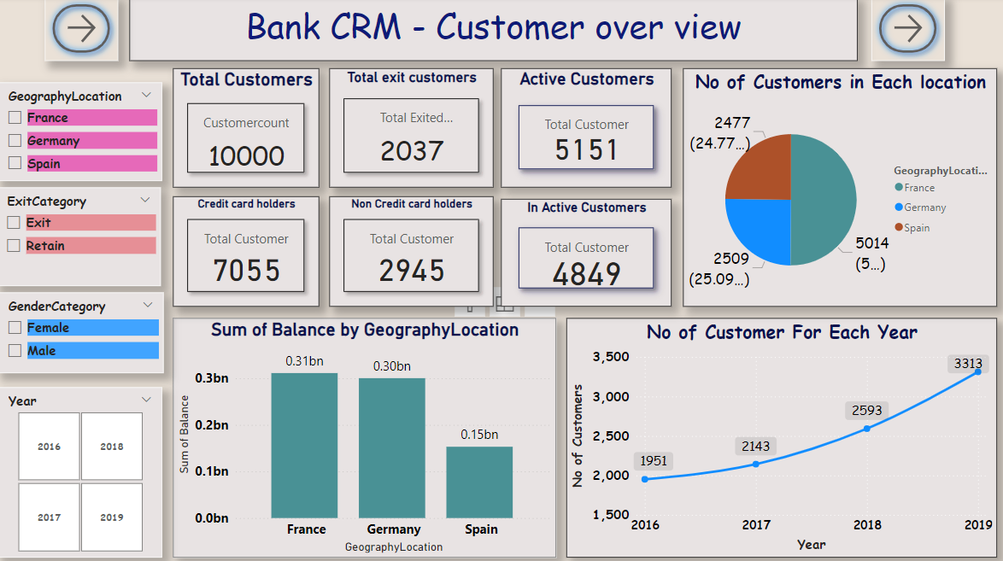
Reports

Slide 9
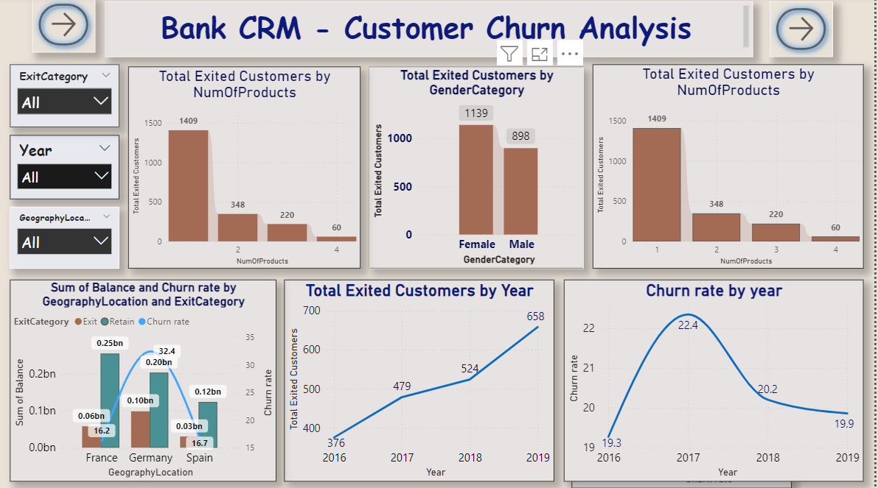
Reports

Slide 10
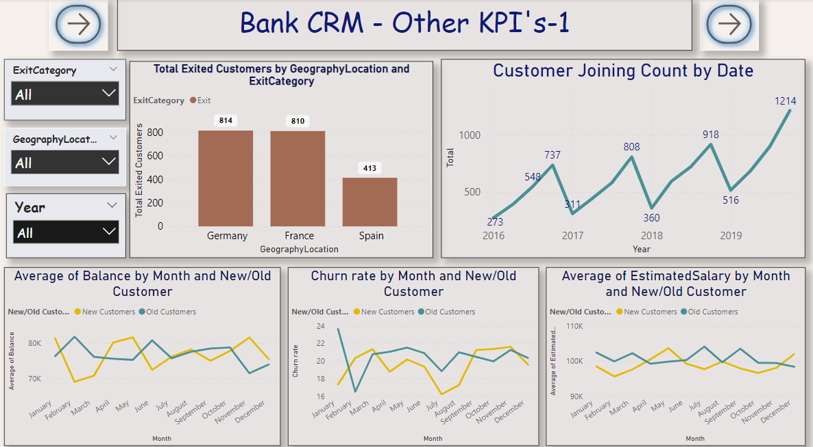
Reports

Slide 11
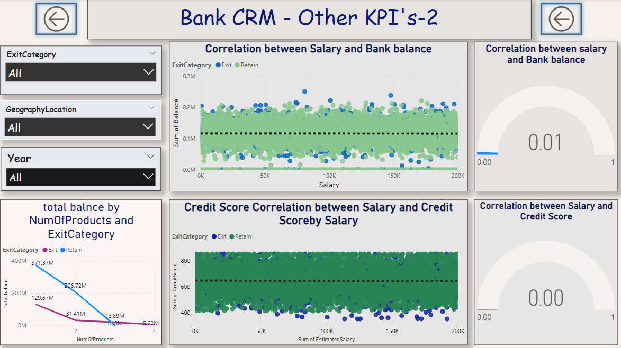
Reports

Slide 12

Reports

